Slide 1
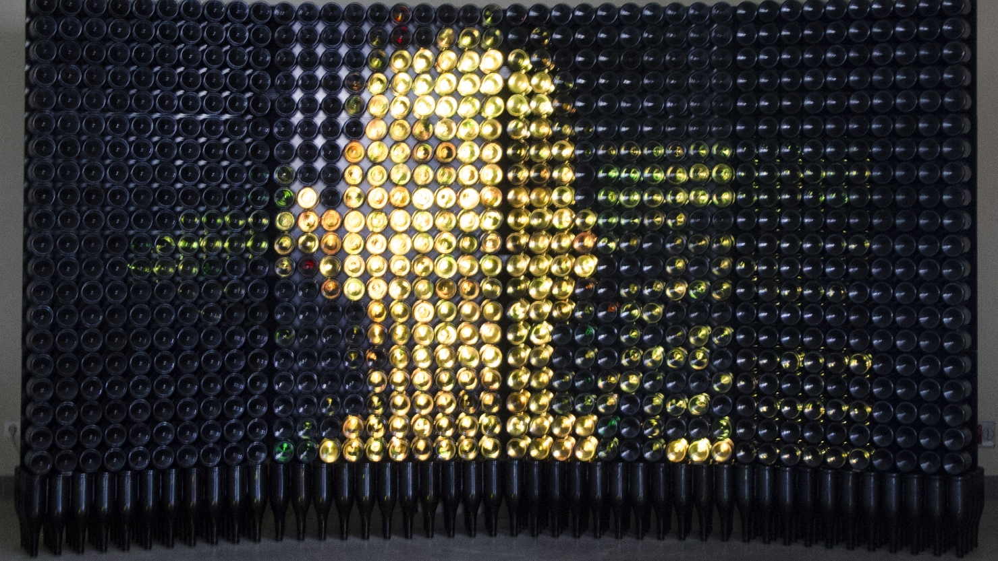
“Communication – message”
installation by Marius Bumbulis
@ 2018 competition

Slide 2
We design meeting points for humans and art. By bringing them together through our events and virtual spaces, we invite people across the world to connect to the freshest ideas and perspectives born in the Nordic and Baltic region.

Slide 3
CHALLENGES FOR YOUNG ARTISTS
Struggle of getting recognition
No community in the region
Public has limited access to art
How to become full time artist?
Unique international competition
Only for graduates of art universities
Professional selection & jury
Long term online visibility

Slide 4
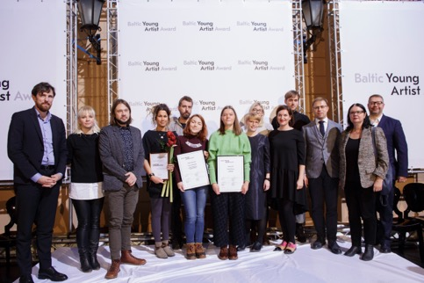
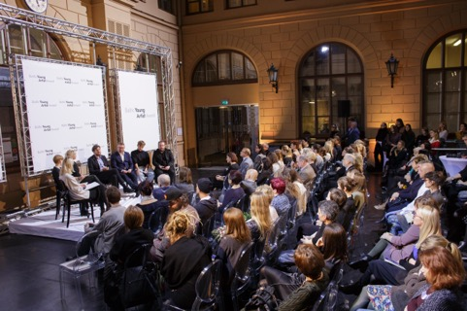
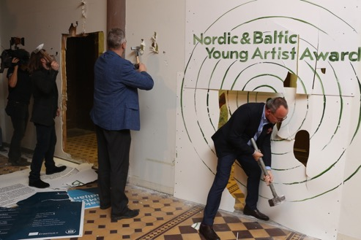
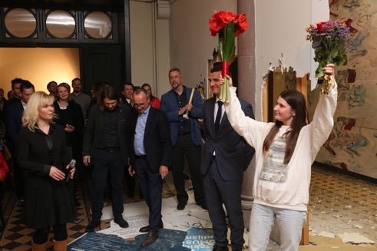
MAIN PRIZE
2 000 €
& PARTICIPATION
IN ARTVILNIUS
PUBLIC CHOICE
500€
Estonia, Latvia, Lithuania, Finland
100 young artists
SPECIAL PRICE FOR PAINTINGS
200 works of art
3 000 public votes
AWARD CEREMONY @ SELECTED
PARTNER UNIVERSITY
& VIP art tour

Slide 5
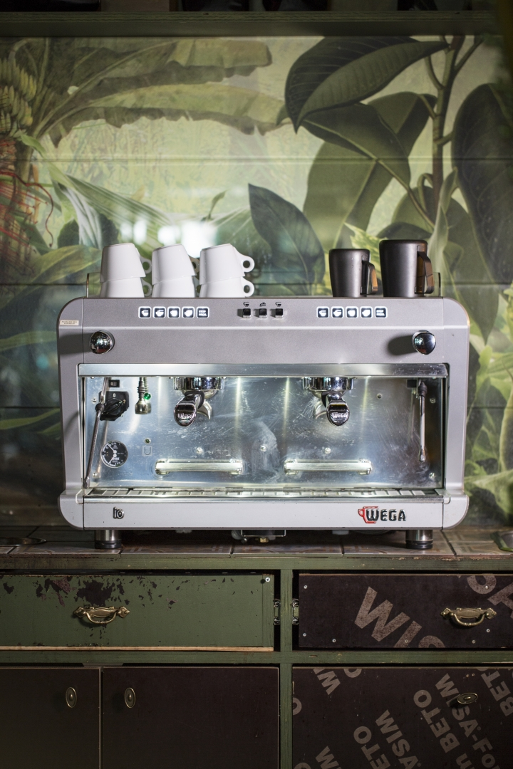
TIME TABLE of NOBA awards
May Works submissions
Jury visiting art shows:
May Finland MA
May Lithuania
June Estonia
June Latvia
September Finland BA
September- Public voting: Delfi & nobaac.com
October
October Jury decision
November Award ceremony & VIP art tour & conference
Elo Strauss “ Marta”

Slide 6
WHY TO SUPPORT?
Present young emerging fine artists
Position your brand with regional cultural scene
Join the circle of art lovers and access art scene
1,5 mln
REACH
4 ART UNIVERSITIES
30 PUBLICATIONS
43 ART INSTITUTES
Colt by Eimante Simkute

Slide 7
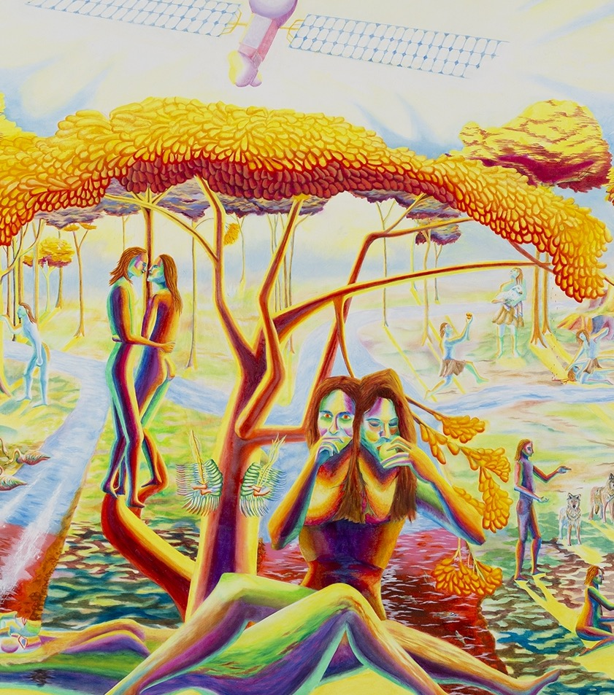
MEDIA & PR
Delfi: EE, LT & LV (public voting)
Www & news letters & social media (fb, instagram, youtube) of art universities, NOAR, NBYAA, artist & partners involved
Press releases and news publication (online, print, radio, tv) in 4 countries before, during and after the ceremony
Award ceremony @ selected partner university incl. VIP art tour, press, videos, photo walls etc.
Can we receive the Tree of life? The way to eternal life?
by Nils Titus Östbrant

Slide 8
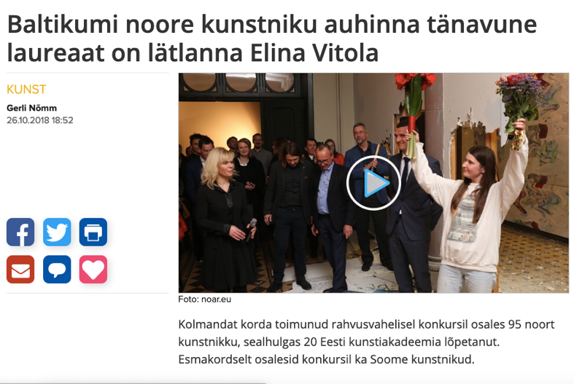
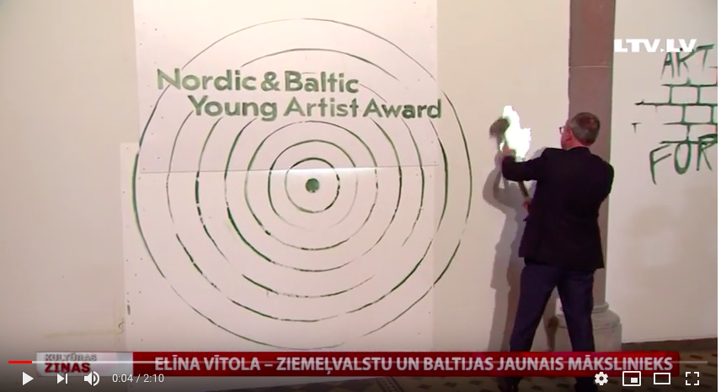
EXAMPLES OF MEDIA
Estonian broadcasting TV news - “Baltikumi noore kunstniku auhinna tänavune laureaat on lätlanna Elina Vitola“
TVnet.lv – “Par Ziemeļvalstu un Baltijas šī gada labāko jauno mākslinieku konkursā atzīta Elīna Vītola “
LTV (TV channel) - Elina Vitola winning the NBYAA main prize, reportage of the event
Delfi.ee – „Kaasaegne kunst koju — vaata, millised ägedad teosed ja kunstnikud kandideerivad Põhjamaade ja Baltikumi noore kunstniku auhinnale”
Delfi Kultura (LV) - Elina Vitola winning the NBYAA main prize
Arterritory. com - Reportage of NBYAA award ceremony
Sirp - “ Nordic & Baltic Young Artist Award goes to Elina Vitola. (EST) 09.11.2018 “

Slide 9
MEDIA |  | SUPPORTER | FOLLOWER | ENDORSER | INFLUENCER
 |  | 500 € | 1500 € | 3 000 € | 6 000 €
Print | Company’ s flyers in award ceremony |  |  |  | x
Online | Presenter of Delfi public voting (in negotiations) |  |  |  | x
BTL | Special solution according to brand |  |  | x | x
Live | Prize presenter at the award ceremony |  |  | Special prize | Grand Prix & public choice
 | Award ceremony tickets |  |  | x | x
 | 3 VIP art tours EE, LV, LT |  | x | x | x
TV / Radio | Interviews in cultural news section |  | x | x | x
Online/print | 30 press releases & publications |  | x | x | x
Social media | 4 universities, NOAR, partners |  | x | x | x
Service | Discount of lending art |  | 15% | 20% | 25%
Service | Discount of buying art |  | 5% | 10% | 15%
Print | Logo on NBYAA flyers |  | x | x | x
www | 4 universities |  | x | x | x
 | NBYAA.eu , NOAR.eu | x | x | x | x

Slide 10
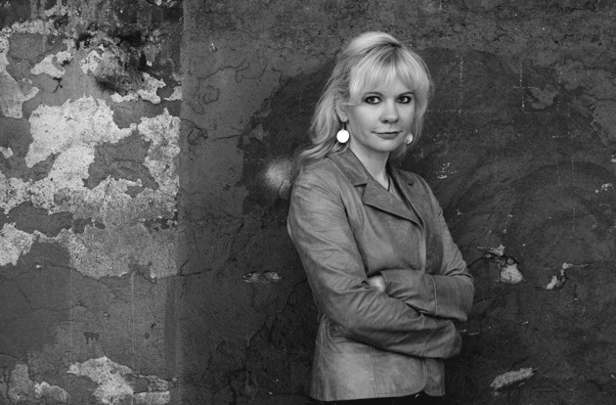
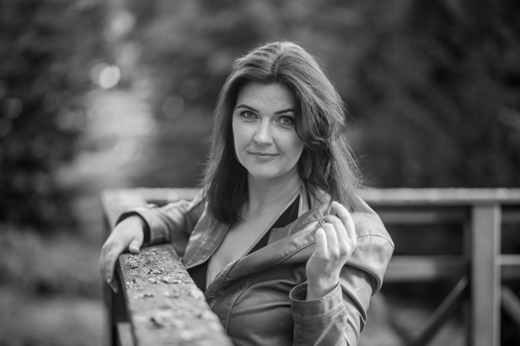
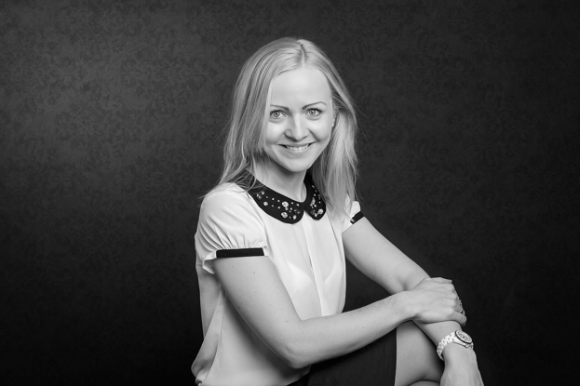
TEAM
Andra Orn
NOBA management andra@nobaac.com
Founder/manager of NOAR & Tallinn Art Week & NBYAA, 10 Y experiences in the field
Egle Loor
Communication egle@nobaac.com
15 Y experiences in PR & marketing previously @IDEA
Kelli Turmann
Project management kelli@nobaac.com
10 Y experiences in project management, previously @EDC @EKA

Slide 11
LOOKING FORWARD TO DRIVE THE ART ROAD TOGETHER!
NOBAAC.com
From cycle Distant Proximity by Sonata Riepšaitė

